Slide 1
基于同心区域按区域的使用3D激光雷达地面分割与地面似然估计
Patchwork：Concentric Zone-based Region-wise Ground Segmentation with Ground Likelihood Estimation Using a 3D LiDAR Sensor
主 讲 人：K.Fire
高校：某知名双非大学
公 众 号：3D视觉工坊

Slide 2
Outline
1
Introduction
2
Method
3
Experiments
4
Conclusion

Slide 3
1
Introduction

Slide 4
Introduction
Two main purpose of ground segmentation:
Main Contributions:
1. One is to estimate the movable area for successful navigation
2.other is to recognize or track moving objects.
a) An efficient, nonuniform, region-wise representation of a 3D point cloud is proposed, referred to as a CZM–based representation whose bin size is different depending on each zone.
b) Also, we leverage Ground Likelihood Estimation (GLE) in terms of uprightness, elevation, and flatness to determine whether each bin is ground.
c) The proposed method shows promising performance over the state-of-the-art at more than 40 Hz. In particular, Patchwork estimates the ground points with the least recall variance, which shows that our proposed method overcomes the undersegmentation issue in complex urban environments.
Three main issues about precise GS:
1.There exists a partially steep slope or bumpy road.
2.Curbs or flower beds make some regions uneven.
3.Because all surrounding objects are taken into account as outliers, which hinder plane fitting.
sensor height-non-precise
RANSAC-computational time
extraordinary

Slide 5
2
Method

Slide 6
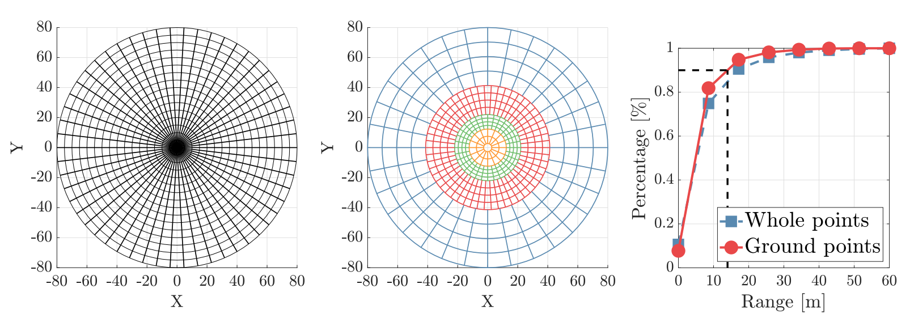

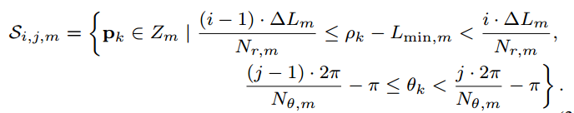
Concentric Zone Model
Assumption: The ground can be flat within the bins
uniform polar grid representation (X)
-sparsity issue
-representability issue
Adaptively adjust the size of bins with the logarithmic point distribution --do not resolve sparsity issue
me:computational issue
The sizes of bins in Z1 and Z4 are set larger
to resolve the sparsity issue and representability issue.
Conparing with R-GPF, the numbers of bins reduces from 3,240 in S to 504 in C, thus enabling
operation at more than 40 Hz

Slide 7
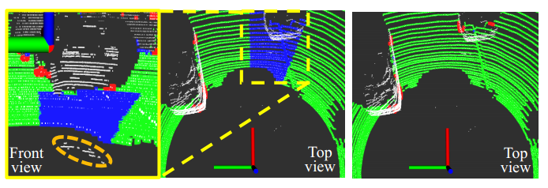
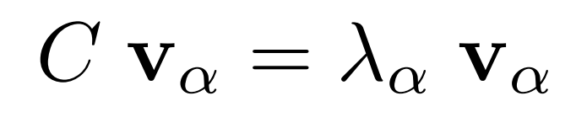
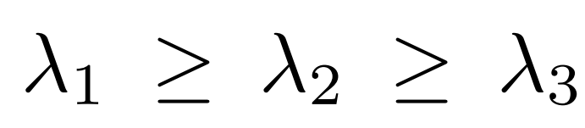
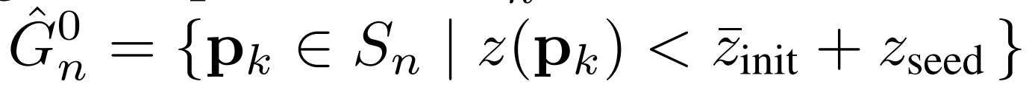
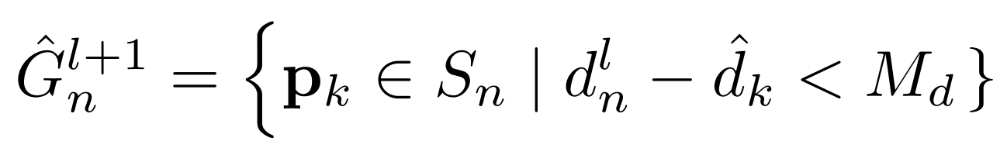
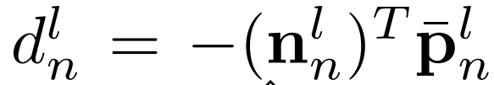
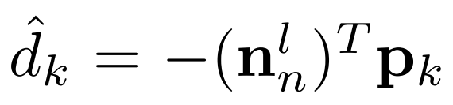
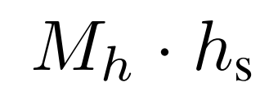
Region-wise Ground Plane Fitting
·PCA
Erroneous cloud points below the actual ground are acquired due to the multipath problem or reflection of LiDAR signals.
Filter the point that is lower than
where, M is adaptively adjust and lower than -1.
Clustering issues

Slide 8
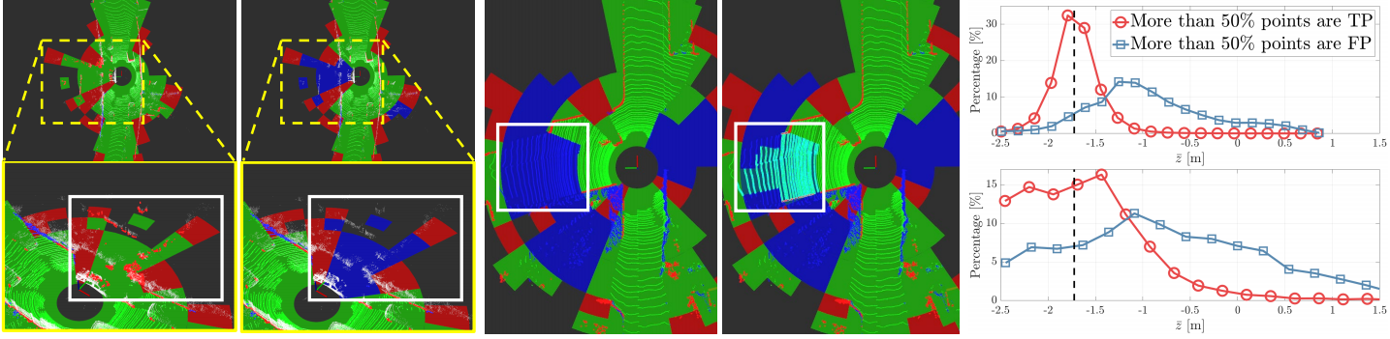


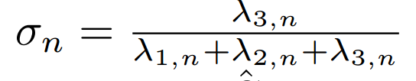



Ground Likelihood Estimation
Binary Classification
NOTE:coded simplify
Uprightness
Elevation
Flatness
The bonnet or roof of a car, or when large objects, such as cars, are close to the sensor frame, occlusion occurs, thus giving rise to the partial observation issue.
steep uphills
The aim of flatness is to revert some FNs filtered by the elevation if they are definitely an even plane.

Slide 9
3
Experiments

Slide 10
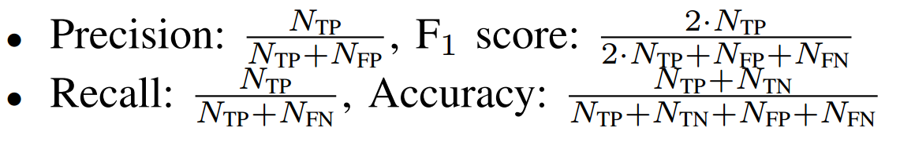
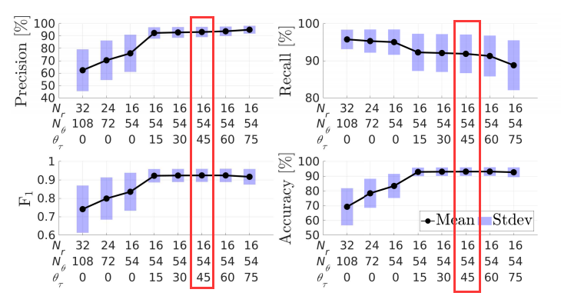
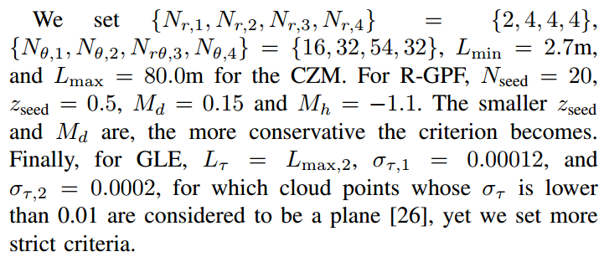
Experiments
Performance Analysis with Different Bin Sizes
Size of bins

Slide 11
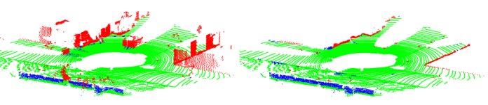
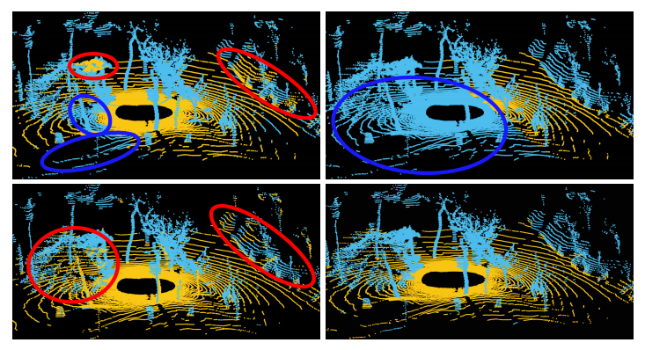
Experiments
Effectiveness of Ground Likelihood Estimation
·Green: TPs(↑)
·Blue: FNs(↓)
·Red: FPs(↓)
·Yellow: TPs(↑)
·Cyan: FPs(↓)
·Blue circles: FNs
·Red circles: FPs

Slide 12
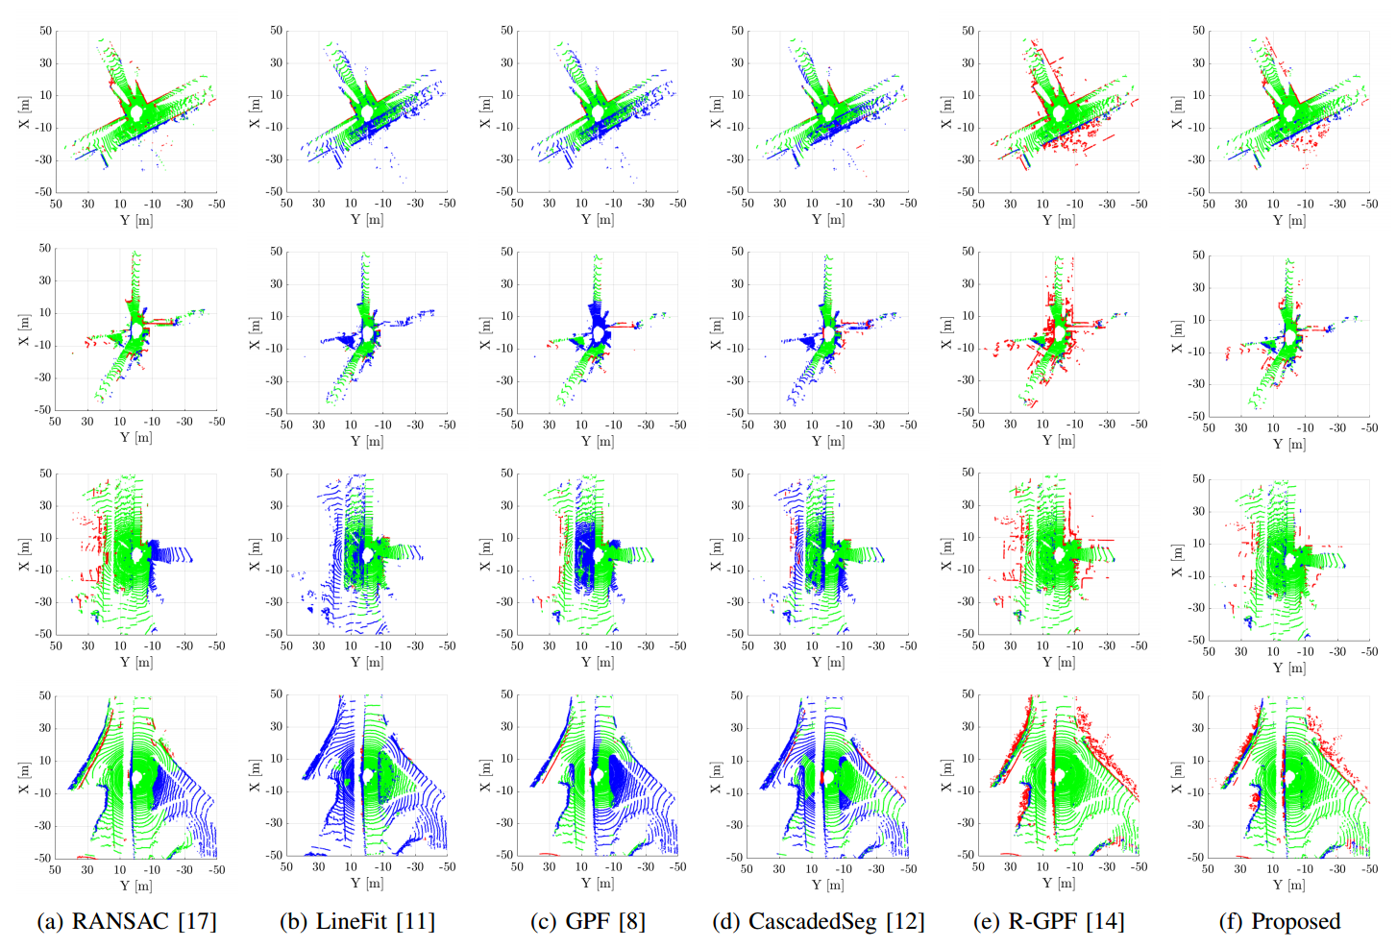
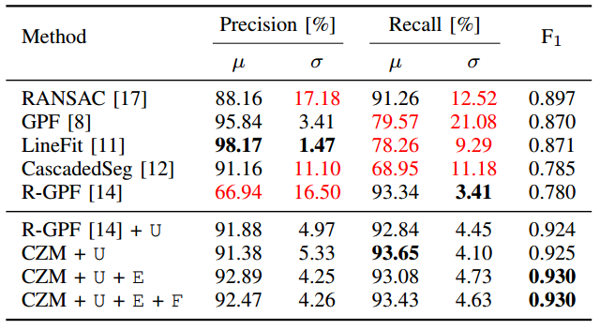
Experiments
·Green: TPs(↑)
·Blue: FNs(↓)
·Red: FPs(↓)
Comparison with SOTA Methods
The comprehensive level is the best and stable

Slide 13
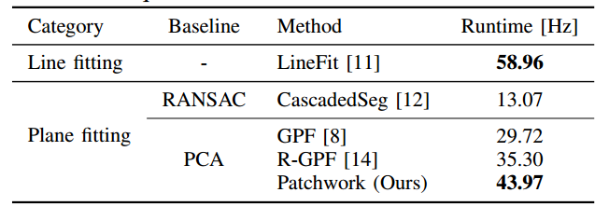
Experiments
Algorithm speed
Shows the fastest speed among various multiple plane fitting-based methods.
The proposed method is faster than R-GPF and RANSAC-based method.

Slide 14
4
Conclusion

Slide 15
Conclusion
Conclusion and Restriction
Future works:
1.The detection of moving objects.
2.To devise a deep learning–aided ground likelihood estimation for more sophisticated ground segmentation.
3.Application for LeGO-LOAM, or other SLAM system...
inspiration:
1.Great truths are always simple
2.The conbimation of Elevation and Flatness

Slide 16


添加V: cv3d007，咨询更多
「3D视觉从入门到精通」知识星球
Notes:
这页注意根据本课程名字修改，以及替换左侧的课程二维码。

Slide 17

欢迎关注3D视觉工坊
公众号
我们这里有3D视觉算法、SLAM、点云处理、三维重建、计算机视觉、深度学习、自动驾驶、图像处理、技术干货以及前沿paper分享！
如果你也想成为主讲人，欢迎加入我们。
请加V：cv3d007，备注：工坊主讲申请
公众号
交流群请添加客服

Slide 18

李奇
感谢聆听
机器人科学与工程专业
机器人科学与工程学院
Thanks for Listening

